Slide 1
IS 301 DECISION SUPPORT SYSTEMS
DECISION SUPPORT SYSTEMS AND INTELLIGENT SYSTEMS,
Seventh Edition
Efraim Turban, Jay E. Aronson, and Ting-Peng Liang
Chapter 6
Data Warehousing and OLAP Technology
College of Computer Science and Information Technology
Department of Computer Information Systems
Prof Dr. Taleb A. S. Obaid

Slide 2
LEARNING OBJECTIVES
What is a data warehouse?
Data warehouse design issues.
General architecture of a data warehouse
Introduction to Online Analytical Processing (OLAP) technology.
Data warehousing and data mining relationship.

Slide 3
الفرق بين قواعد البيانات ومخازن البيانات
كل من مخازن البيانات وقواعد البيانات هو قاعدة بيانات.
قواعد البيانات المعتادة تستخدم في العمليات اليومية من إدخال وتعديل وحذف واستعلام فوري، ولذلك تصنف تحت بند أنظمة On-Line Transaction Processing (OLTP).
مخازن البيانات لا تُستخدم في العمليات اليومية المعتادة، بل الهدف منها هو تنفيذ استعلامات تحليلية طويلة، On-Line Analytical Processing (OLAP) واستخراج تقارير معقدة بهدف تسهيل اتخاذ القرارات في المنشآت الكبيرة، ولذلك فهي للقراءة فقط.
تكون مخازن البيانات كبيرة الحجم، لأنها تحتفظ ببيانات تاريخية كبيرة، وقد تجمع بيانات من عدة مصادر (قواعد بيانات أقسام اخرى)، في حين تميل قواعد البيانات إلى التخلص دورياً من البيانات التاريخية التي لا تدخل في استعلامات دورية.
تصميم قواعد البيانات يتوجه أساساً نحو التأكد من سلامة الإدخال وتكامل قاعدة البيانات، والتخلص من البيانات غير الصحيحة وتطبيق عمليات الحذف والتعديل والإضافة ولا يهدف إلى ضمان الأداء الأمثل للاستعلامات الطويلة، على العكس، يهد ف تصميم مخازن البيانات إلى ضمان الأداء الأمثل للاستعلامات المعقدة، ولذلك تجد عدد الجداول أقل، وقد تتم عمليات إزالة تسوية.
بالنسبة للحجم، فهو صعب التحديد بالدقة، لأنه ليس هذا هو الفارق الجوهري، وإنما نتيجة له، وإن كان من الطبيعي أن تكون مخازن البيانات أكبر وتبلغ حدود التيرابايت.

Slide 4
Understanding a Data Warehouse
A data warehouse is a database, which is kept separate from the organization's operational database.
There is no frequent updating done in a data warehouse.
It possesses consolidated historical data, which helps the organization to analyze its business.
A data warehouse helps executives to organize, understand, and use their data to take strategic decisions.
Data warehouse systems help in the integration of diversity of application systems.
A data warehouse system helps in consolidated historical data analysis.

Slide 5
DATA WAREHOUSING
A data warehouse begins with the physical separation of a company's operational and decision support environments.
At the heart of many companies lies a store of operational data.
It is important to physically separate the data warehouse from the OLTP system.

Slide 6
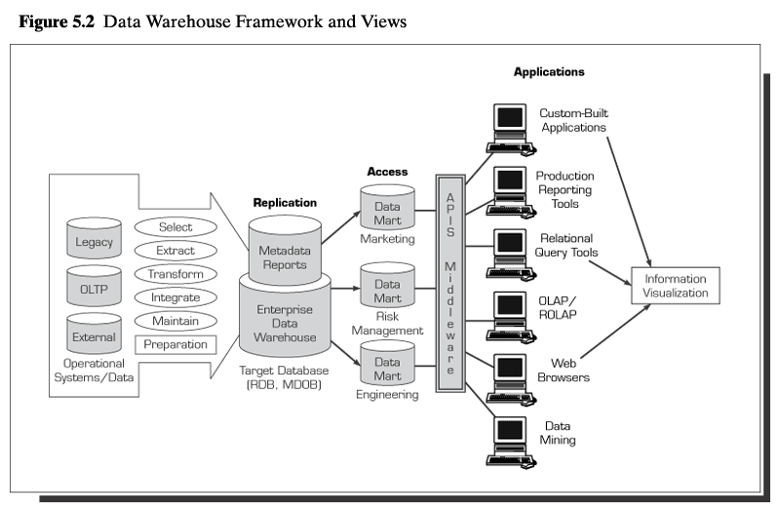

Slide 7
2. What is Data Warehouse?
2.1. Definitions
“A data warehouse is a subject-oriented, integrated, time-variant, and nonvolatile collection of data in support of management’s decision-making process.”
Operational Data: Data used in day-to-day needs of company.
Data mining tools often access data warehouses rather than operational data.

Slide 8
CHARACTERISTICS OF DATA WAREHOUSING
(Bill Inmon): Subject Oriented: Data that gives information about a particular subject instead of about a company's ongoing operations. Data Warehouse— Subject-Oriented
Organized around major subjects, such as customer, product, sales.
Focusing on the modeling and analysis of data for decision makers, not on daily operations or transaction processing.
Integrated: Data that is gathered into the data warehouse from a variety of sources and merged into a coherent whole
Data Warehouse— Integrated
Constructed by integrating multiple, heterogeneous data sources
Data cleaning and data integration techniques are applied.

Slide 9
CHARACTERISTICS OF DATA WAREHOUSING
Time-variant: All data in the data warehouse is identified with a particular time period.
Data Warehouse— Time Variant
The time horizon for the data warehouse is significantly longer than that of operational systems.
Data warehouse: provide information from a historical perspective (e.g., past 5-10 years)
Every key structure in the data warehouse
Contains an element of time, explicitly or implicitly

Slide 10
CHARACTERISTICS OF DATA WAREHOUSING
Non-volatile: Data is stable in a data warehouse. More data is added but data is never removed. This enables management to gain a consistent picture of the business.
Data Warehouse— Non-Volatile
A physically separate store of data transformed from the operational environment.
Operational update of data does not occur in the data warehouse environment.
Does not require transaction processing, recovery, and concurrency control mechanisms
Requires only two operations in data accessing:
Initial loading of data and access of data.

Slide 11
2.6. Data Warehouse vs. Heterogeneous DBMS
Traditional heterogeneous DB integration:
Build wrappers/mediators on top of heterogeneous databases
Query driven approach
When a query is posed to a client site, a meta-dictionary is used to translate the query into queries appropriate for individual heterogeneous sites involved, and the results are integrated into a global answer set
Complex information filtering, compete for resources
Data warehouse: update-driven, high performance. Information from heterogeneous sources is integrated in advance and stored in warehouses for direct query and analysis

Slide 12
2.7. Data Warehouse vs. Operational DBMS
OLTP (online transaction processing) is a class of software programs capable of supporting transaction-oriented applications on the Internet. Typically, OLTP systems are used for order entry, financial transactions, customer relationship management (CRM) and retail sales
OLTP (On-Line Transaction Processing)
Major task of traditional relational DBMS
Day-to-day operations: purchasing, inventory, banking, manufacturing, payroll, registration, accounting, etc.

Slide 13
2.7. Data Warehouse vs. Operational DBMS
OLAP is a powerful technology for data discovery, including capabilities for limitless report viewing, complex analytical calculations, and predictive “what if” scenario (budget, forecast) planning.
OLAP (on-line analytical processing)
Major task of data warehouse system
Data analysis and decision making

Slide 14
2.7. Data Warehouse vs. Operational DBMS
- OLTP (On-line Transaction Processing) is characterized by a large number of short on-line transactions (INSERT, UPDATE, DELETE). The main emphasis for OLTP systems is put on very fast query processing, maintaining data integrity in multi-access environments and an effectiveness measured by number of transactions per second. - OLAP (On-line Analytical Processing) is characterized by relatively low volume of transactions. Queries are often very complex and involve aggregations. For OLAP systems a response time is an effectiveness measure. OLAP applications are widely used by Data Mining techniques. In OLAP database there is aggregated, historical data, stored in multi-dimensional schemas (usually star schema).

Slide 15
2.7. Data Warehouse vs. Operational DBMS
Distinct features (OLTP vs. OLAP):
User and system orientation: customer vs. market
Data contents: current, detailed vs. historical, consolidated
Database design: ER + application vs. star + subject
View: current, local vs. evolutionary, integrated
Access patterns: update vs. read-only but complex queries

Slide 16
2.8. OLTP vs. OLAP
 | OLTP | OLAP
Users | Clerk, IT professional | Knowledge worker
Function | Day to day operations | Decision support
DB design | Application-oriented | Subject-oriented
Data | Current, up-to-date Detailed, flat relational Isolated | Historical, Summarized, multidimensional Integrated, consolidated
Usage | Repetitive | ad-hoc
Access | Read/write, Index/hash on prim. Key | Lots of scans
Unit of work | Short, simple transaction | Complex query
# records accessed | Tens | Millions
#users | Thousands | Hundreds
DB size | 100 MB-GB | 100 GB-TB
Metric | Transaction throughput | Query throughput, response

Slide 17
4. Conceptual Modeling of Data Warehousing
Modeling data warehouses: dimensions & measures
Star schema: A fact table in the middle connected to a set of dimension tables
Snowflake schema: A refinement of star schema where some dimensional hierarchy is normalized into a set of smaller dimension tables, forming a shape similar to snowflake
Fact constellations: Multiple fact tables share dimension tables, viewed as a collection of stars, therefore called galaxy schema or fact constellation

Slide 18
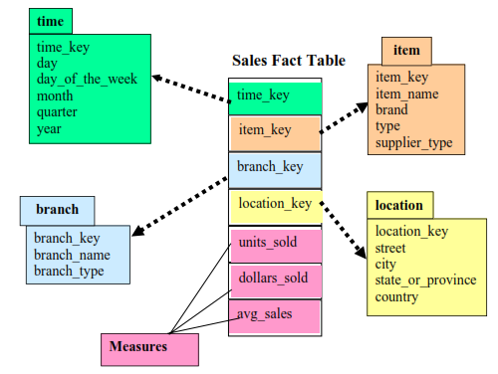
4.1. Star Schema

Slide 19
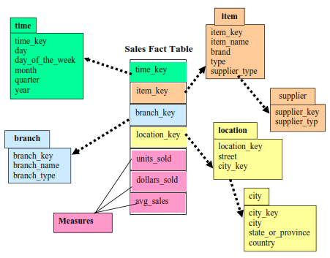
4.2 Snowflake Schema

Slide 20
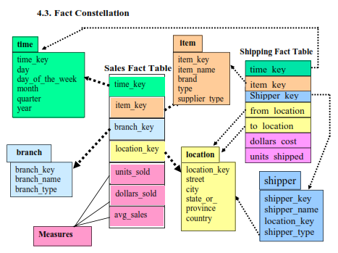
4.3. Fact Constellation

Slide 21
5. A Data Mining
Data mining is an interdisciplinary subfield of computer science. It is the computational process of discovering patterns in large data sets involving methods at the intersection of artificial intelligence, machine learning, statistics, and database systems.

Slide 22
Data Mining
There is a Huge amount of data available in the Information Industry.
To analyze this huge amount of data and extract useful information from it.
Extraction of information is not the only process;
Data mining also involves other processes such as Data Cleaning, Data Integration, Data Transformation, Pattern Evaluation and Data Presentation.
Once all these processes are over, we would be able to use this information in many applications such as Fraud Detection, Market Analysis, Production Control, Science Exploration, etc.

Slide 23
What is Data Mining?
DM is defined as extracting information from huge sets of data.
DM is the procedure of mining knowledge from data. The information or knowledge extracted so can be used for any of the following applications:
Market Analysis
Fraud Detection
Customer Retention
Production Control
Science Exploration

Slide 24
Data Mining Applications
Data mining is highly useful in the following domains:
Market Analysis and Management
Corporate Analysis & Risk Management
Fraud Detection
Apart from these, data mining can also be used in the areas of production control, customer retention, science exploration, sports, astrology, and Internet Web Surf-Aid

Slide 25
5. A Data Mining Query Language: DMQL
5.1. Definitions and syntax
Similar to RDBMS, we need a DDL (Data Definition Language) to define the tables in the conceptual model.
Cube Definition (Fact Table)
Syntax:
define cube <cube_name> [<dimension_list>]: <measure_list>
Example
define cube sales_star [time, item, branch, location]:
dollars_sold = sum(sales_in_dollars),
avg_sales = avg(sales_in_dollars),
units_sold = count(*)

Slide 26
5.3. Defining a Snowflake Schema in DMQL
define cube sales_snowflake [time, item,
branch, location]:
dollars_sold = sum(sales_in_dollars),
avg_sales = avg(sales_in_dollars),
units_sold = count(*)
define dimension time as (
time_key, day, day_of_week, month,
quarter, year)
define dimension item as (
item_key, item_name, brand, type,
supplier(supplier_key, supplier_type)
)
define dimension branch as (branch_key, branch_name, branch_type)
define dimension location as (location_key, street,
city(city_key, province_or_state, country)
)

Slide 27
5.4. Defining a Fact Constellation in DMQL
define cube sales [time, item, branch, location]:
dollars_sold = sum(sales_in_dollars), avg_sales = avg(sales_in_dollars), units_sold = count(*)
define dimension time
as (time_key, day, day_of_week, month, quarter, year)
define dimension item
as (item_key, item_name, brand, type, supplier_type)
define dimension branch
as (branch_key, branch_name, branch_type)
define dimension location
as (location_key, street, city, province_or_state, country)

Slide 28
5.4. Defining a Fact Constellation in DMQL
define cube shipping [time, item, shipper, from_location, to_location]:
dollar_cost = sum(cost_in_dollars), unit_shipped = count(*)
define dimension time as time in cube sales
define dimension item as item in cube sales
define dimension shipper
as ( shipper_key, shipper_name, location as location in cube sales, shipper_type)
define dimension from_location
as location in cube sales
define dimension to_location
as location in cube sales

Slide 29
5.5. Measures: Three Categories
• A data cube function is a numerical function that can be evaluated at each point in the data cube space.
• Given a data point in the data cube space:
Entry(v₁, v₂, …, v_{n})
where v_{i} is the value corresponding to dimension d_{i}.
We need to apply the aggregate measures to the
dimension values v1, v2, …, vn

Slide 30
5.5. Measures: Three Categories
Distributive:
If the result derived by applying the function to n aggregate values is the same as that
derived by applying the function on all the data without partitioning.
Example: count(), sum(), min(), max().
Algebraic:
Use distributive aggregate functions.
If it can be computed by an algebraic function with M arguments (where M is a bounded integer), each of which is obtained by applying a distributive aggregate function.
o Example: avg(), min_N(), standard_deviation().

Slide 31
5.6. How to compute data cube measures?
How do evaluate the dollars_sold and unit_sold in the star schema of the previous example?
Assume that the relation database schema corresponding to our example is the following:
time (time_key, day, day_of_week, month, quarter, year)
item (item_key, item_name, brand, type, supplier(supplier_key, supplier_type))
branch (branch_key, branch_name, branch_type)
location (location_key, street, city, province_or_state, country)
sales (time_key, item_key, branch_key, location_key, number_of_unit_sold, price)

Slide 32
5.6. How to compute data cube measures?
Let us then compute the two measures we have in our data
cube: dollars_sold and units_sold
select s.time_key, s.item_key, s.branch_key,
s.location_key, sum(s.number_of_units_sold*s.price), sum(s.number_of_units_sold)
from time t, item i, branch b, location l, sales s
where s.time_key = t.time_key
and s.item_key = i.item_key
and s.branch_key = b.branch_key
and s.location_key = l.location_key
group by s.time_key, s.item_key, s.branch_key, s.location_key

Slide 33
A Sample data cube:

Slide 34
5.6. How to compute data cube measures?
• Relationship between “data cube” and “group by”?
The above query corresponds to the base cuboid.
By changing the group by clause in our query, we may generate other cuboids.
What is query for the 0-D cuboid or apex?

